Slide 1
EU ASYLUM LAW A BIRD’S EYE VIEW
Presentation of Boldizsár Nagy the fifth Summer School of Human Rights of the consortium of Russian universities «Social vulnerability: modern challenges and international protection»

Slide 2
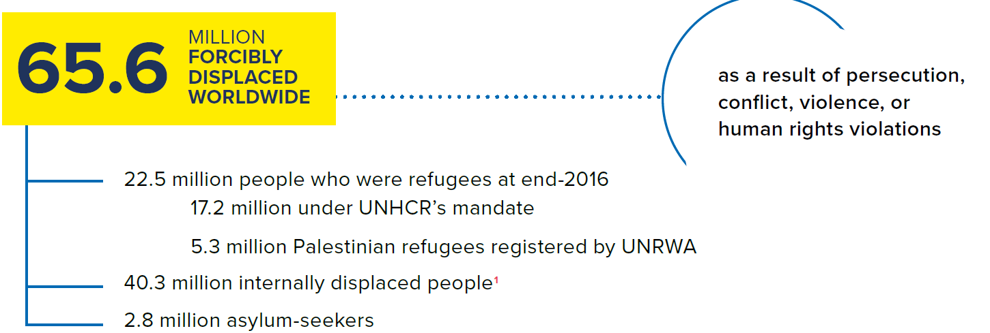
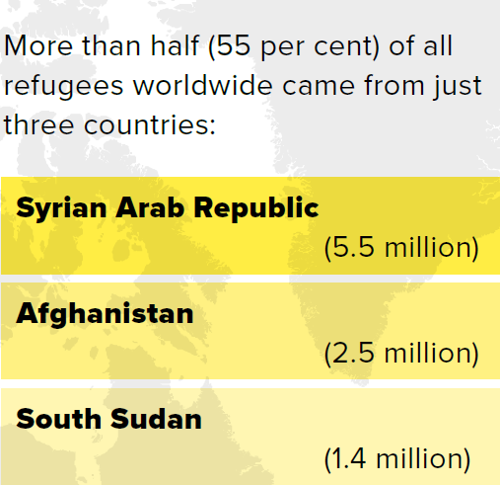
Global figures, end of 2016
51% of the refugees are minors
552,200 refugees returned home
in 2016
189,300 refugees were admitted to resettlement
Source: UNHCR: Global Trends. Forced displacement in 2016. Geneva, 2017, various pages http://www.unhcr.org/statistics/unhcrstats/5943e8a34/global-trends-forced-displacement-2016.html (20170627)

Slide 3
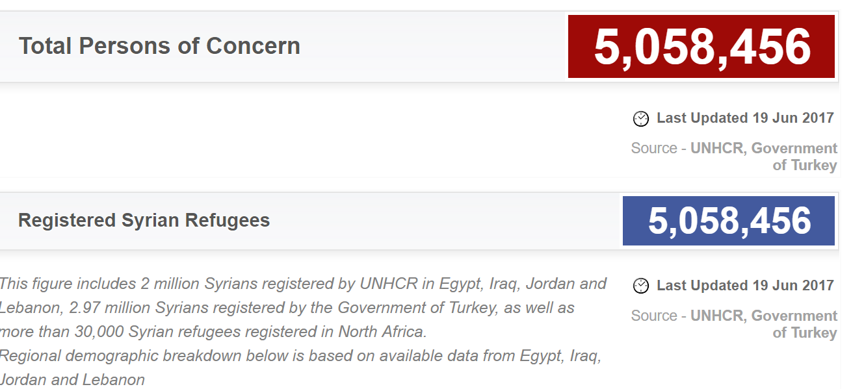
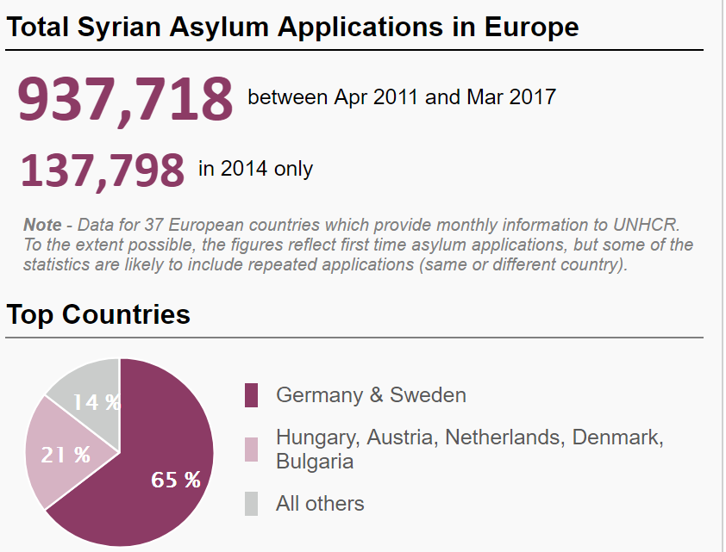
Syria! June, 2017
Source: http://data.unhcr.org/syrianrefugees/country.php?id=224 (20170627) author’s assemblage
Egypt: 122,228
Iraq: 241,406
Jordan: 660,785 Lebanon: 1,011366
Turkey: 2,992,567

Slide 4
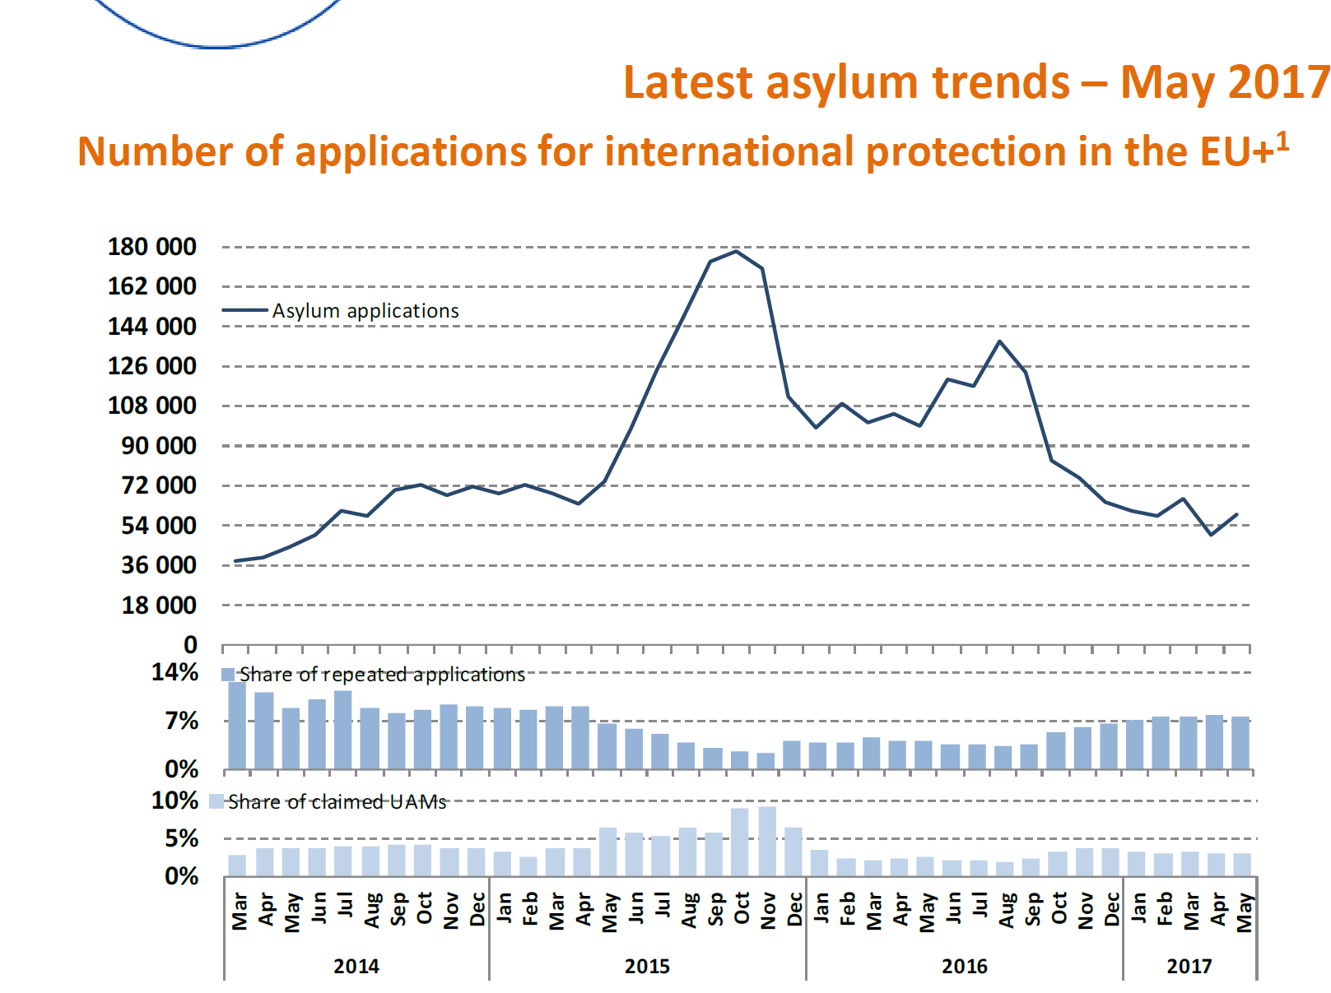
Individual applications in the EU+
Source: EASO, Latest Asylum Trends, 2017, May, p. 1. https://www.easo.europa.eu/latest-asylum-trends (20170627)

Slide 5
DEFINITIONS

Slide 6
European Union: subregional law
„Convention refugee”
„Political refugee”
Beneficiary of subsidiary protection
Victims of civil war or threatened with inhuman or degrading treatment or punishment or death penalty
Beneficiary of temporary protection
„Mass influx” from conflict, endemic violence or systemic violations of human rights
Details later
Notes:
EU Temporary Protection Directive
(Council Directive 2001/55/EC OJ L 212/14)
Article 2
For the purposes of this Directive:
‘temporary protection’ means a procedure of exceptional character to provide, in the event of a mass influx or imminent mass influx of displaced persons from third countries who are unable to return to their country of origin, immediate and temporary protection to such persons, in particular if there is also a risk that the asylum system will be unable to process this influx without adverse effects for its efficient operation, in the interests of the persons concerned and other persons requesting protection;
...
(c) ‘displaced persons’ means third-country nationals or stateless persons who have had to leave their country or region of origin, or have been evacuated, in particular in response to an appeal by international organisations, and are unable to return in safe and durable conditions because of the situation prevailing in that country, who may fall within the scope of Article 1A of the Geneva Convention or other international or national instruments giving international protection, in particular:
(i) persons who have fled areas of armed conflict or endemic violence;
(ii) persons at serious risk of, or who have been the victims of, systematic or generalised violations of their human rights
______________________________________________________
EU Qualification Directive
2004/2011
Art 2 2004:(e) 2011: (f)
„person eligible for subsidiary protection” [means someone], „who does not qualify as a refugee but in respect of whom substantial grounds have been shown for believing that the person concerned, if returned to his or her country of origin, or in the case of a stateless person, to his or her country of former habitual residence, would face a real risk of suffering serious harm as defined in Article 15, .....is unable, or, owing to such risk, unwilling to avail himself or herself of the protection of that country;
Art 15 (in both)
Serious harm consists of:
(a) death penalty or execution; or
(b) torture or inhuman or degrading treatment or punishment of an applicant in the country of origin; or
(c) serious and individual threat to a civilian's life or person by reason of indiscriminate violence in situations of international or internal armed conflict”

Slide 7
Asylum acquis
Adopted and proposed measures
1. Regulation on Eurodac (2000) recast: 2013. Proposal for regulation 2016
2. Directive on temporary protection (2001)
3. Reception conditions directive (2003) recast: 2013 Proposal for directive (recast 2): 2016
4. Dublin II Regulation and its implementing rules (2003) recast: 2013 Proposal for regulation (recast 2): 2016
5. Qualification (Refugee definition) directive (2004) recast: 2011. Proposal for regulation: 2016
6. Asylum procedures directive (2005) recast: 2013. Proposal for regulation: 2016
7. Establishment of an European Asylum Support Office (2010) Proposal for regulation on European Asylum Agency: 2016
8. Decision on the new Asylum Migration and Integration Fund – 2014
9. Solidarity measures, 2015: resettlement and relocation (See also 2016 Dublin proposal)
Notes:
On11 May 2016, a first package of legislative proposals, containing:
• a recast of the Dublin Regulation establishing the criteria and mechanisms for determining the Member State responsible for examining an application for international protection (doc 8715/16);
• a Regulation on the European Union Agency for Asylum, replacing the EASO Regulation (doc 8742/16);
• a recast of the Regulation on the establishment of 'Eurodac' (doc 8765/16); − on 18 July 2016, a second package of legislative proposals, which contains:
• a Regulation establishing a common procedure for international protection in the EU (replacing the Asylum Procedures Directive) (doc 11317/16 + ADD 1 + ADD 2);
• a Regulation on qualification of third-country nationals or stateless persons as beneficiaries of international protection (replacing the Qualification Directive) (doc 11316/16 + ADD 1);
• a recast of the Directive for the reception conditions of applicants for international protection (doc 11318/1/16 REV 1);
• a Regulation establishing a Union Resettlement Framework (doc 11313/16)
Quoted from:Doc 12724/16

Slide 8
The Dublin Convention the Dublin II and the Dublin III regulations (1990, 2003 and 2013)
Convention determining the State responsible for examining applications for asylum lodged in one of the Member States of the European Communities (1990) OJ 1997 C 254/1
and
Council Regulation (EC) No 343/2003 of 18 February 2003 establishing the criteria and mechanisms for determining the Member State responsible for examining an asylum application lodged in one of the Member States by a third-country national OJ 2003 L 50/1
Implementing regulation
Commission Regulation (EC) No 1560/2003 of 2 September 2003 laying down detailed rules for the application of Council Regulation (EC) No 343/2003 establishing the criteria and mechanisms for determining the Member State responsible for examining an asylum application lodged in one of the Member States by a third-country national (OJ L 222 of 5 September 2003, p. 1);
REGULATION (EU) No 604/2013 OF THE EUROPEAN PARLIAMENT AND OF THE COUNCIL of 26 June 2013
establishing the criteria and mechanisms for determining the Member State responsible for examining an application for international protection lodged in one of the Member States by a third-country national or a stateless person (recast)
(OJ 2013 L 180/96)
COMMISSION IMPLEMENTING REGULATION (EU) No 118/2014 of 30 January 2014
amending Regulation (EC) No 1560/2003 laying down detailed rules for the application of Council
Regulation (EC) No 343/2003 establishing the criteria and mechanisms for determining the Member
State responsible for examining an asylum application lodged in one of the Member States by a
third-country national
OJ 2014 L 39/1
Notes:
Convention:
Signature: 15 June 1990.
Entry into force:1 September 1997.
Parties: A 15 EU member states, Iceland and Norway
Regulation:
EC Council reg. 343/2003 (18 February 2003), OJ (2003) L 50/1 2003. 02.25
Start of application: 1 September 2003. (In respect of applications submitted after the date and requests for readmission)
Participants: EU member states except for Denmark plus Norway and Iceland
Denmark has a special link to it,
see 2006/188/EC: Council Decision of 21 February 2006 on the conclusion of the Agreement between the European Community and the Kingdom of Denmark extending to Denmark the provisions of Council Regulation (EC) No 343/2003

Slide 9
Purpose and philosophy of Dublin
Every asylum seeker should gain access to the procedure. There must be a MS to determine the case
Only one procedure should be conducted within the Union. A decision by any MS be taken in the name of others = no parallel or subsequent application should take place
Notes:
See The Commission’s suggestion of 2001 (COM) 2001 447 final p.3
Goal: A unified area without internal borders - that justifies tthat only one decision be taken.
Further goals of the regulation:
Closing the gaps of the Dublin Convention
Drawing the consequence of the single visa lists
Speeding up the procedure
Increasing efficiency (the number of persons effectively transferred)

Slide 10
The philosophy of Dublin: under what conditions is taking charge by another state –without investigation of the merits in the first state fair
Fairness preconditions
If the substantive law (the refugee definition) is identical
If procedural rules guarantee equal level of protection at least in terms of
legal remedies (appeals)
access to legal representation
reception conditions (support) during the procedure (detention, e.g.!)

Slide 11
Regulation 604/2013/EU (Dublin III) criteria 8 – 15. §
Criteria of identifying the responsible state (this is the hierarchy)
1 Minor
2 Adult applicant
3 Residence permit, visa
4 Irregular crossing of external border
5 Unnnoticed stay (for 5 months)
6 Visa waived entry
7. Needy family members
Responsibility of the state terminates when the applicant leaves the territory of the EU for 3 months
See: Abdullahi case, CJEUjudgment, 2013 December
Notes:
The responsible state has to be requested as soon as possible but not later than 3 months after the submission of the application. If not: loss of right to transfer
Reply: within 2 months. Silence = agreement In urgent cases: 1 month for reply
Transfer: within 6 month from acceptance to take charge or from the end of procedure in which transfer was challenged = taking charge
______________________________
In case the applicants leaves the state’s territory during the procedure of
determining the responsible state
determining whether she qualifies for status (merits)
or after a negative decision
that state has to take her back.
Reply: within 1 month (if Eurodac based request: 2 weeks)
Taking back: within 6 months from acceptance
= taking back

Slide 12
Regulation 604/2013/EU (Dublin III) Procedure - deadlines
Taking charge (Another MS, in which the applicant did not apply, is responsible for the procedure, not where the applicant submitted the application)
Taking back (Procedure is still pending in the requested state, applicant withdrew her application there or the application was rejected)
Deadlines for request (3 or 2 months) and response (2 months – 2 weeks). Transfer: within 6 months
Silence = approval of the request
Notes:
17, 18 cikkekben a határidők
Új: Sürgős kérelem esetén (ha eltávolítást kivédendő és/vagy fogvatartás során adják be a kérlemet) a választ a kért határ időben, de max. 1 hónapon belül meg kell adni.

Slide 13
The problem of non-performing countries
Greece since 2011
Bulgaria, Hungary repeatedly
Inhuman treatment of asylum seekers – transfers stopped
“Given the worsening situation of asylum-seekers in Hungary, I urge States to suspend any Dublin transfer of asylum-seekers to this country until the Hungarian authorities bring their practices and policies in line with European and international law,” Filippo Grandi UN High Commissioner for Refugees, 2017 April 10
http://www.unhcr.org/news/press/2017/4/58eb7e454/unhcr-urges-suspension-transfers-asylum-seekers-hungary-under-dublin.html (20170627)
M.S.S v Belgium, and Greece, Ap. no. 30696/09, ECtHR Judgment of 21 January 2011 – return to Greece and treatment of a.s. in Greece violates Art 3.
NS contra Secretary of State /UK/ C-411/10 CJEU reference for preliminary ruling Joined with M.E. and Others v Refugee Applications Commissioner, Minister for Justice and Law Reform (Ireland) - CJEU judgment of 21 December 2011 – No return to Greece allowed
CJEU: AG Opinion in Cases C-490/16 A.S and C-646/16 Jafari, 8 June 2017
Humanitarian corridor – not irregular entry
Notes:
Dublin judgments Petrosian 29 Jan 2009 C-19/08 2009:41 transfer deadline; suspensive effect N.S. & M.E. 21 Dec 2011 C-411+493/10 2011:865 conditions in Greece; no transfer Kastrati 3 May 2012 C-620/10 2012:265 withdrawal asylum application K. 6 Nov 2012 C-245/11 2012:685 Art 15; sovereignty and humanitarian clause Halaf 30 May 2013 C-528/11 2013:342 sovereignty clause; Art 18 EU Charter M.A. a.o. 2 Sep 2013 C-648/11 2013:367 transfer of unaccompanied minor Puid 4 Nov 2013 C-4/11 2013:740 responsible State in stead of Greece Abdullahi 12 Dec 2013 C-394/12 2013:813 Art 19(2); meaning of First Member State Mirza 17 Mar 2016 C-695/15 PPU 2016:188 Art 3(3): safe third country Ghezelbash 7 Jun 2016 C-63/15 2016:409 Right to appeal to incorrect MS determination Karim 7 Jun 2016 C-155/15 2016:410 Art 19(2); meaning of First Member State Quarterly Overview of CJEU judgments and pending cases – 2016/4 – p. 3 / 8 (Dublin II and III continued) Date Case nr ECLI:EU:C: Subject pending cases Al Chodor AG: 10 Nov 2016 C-528/15 2016:865 Art 28: definition of risk of absconding Khir Amayry C-60/16 - Art. 27(3)+(4): suspensive effect and time limit of detention Majid Shiri C-201/16 - Art. 27(1)+29(1)+29(2) Aziz Hassan C-360/16 - Art. 23+24 A.S. C-490/16 - Art. 13(1) Dublin III and 'irregular crossing'

Slide 14
Reception conditions directive
Directive 2013/33/EU of the European Parliament and of the Council
of 26 June 2013
laying down standards for the reception of applicants for international protection (recast)
(OJ 2013 L 180/96)
Replacing
COUNCIL DIRECTIVE 2003/9/EC
of 27 January 2003
laying down minimum standards for the reception of asylum seekers
(OJ 2003 L 31/18)

Slide 15
Reception Conditions Directive
New emphasis
Preamble explicitly refers to MS „which are faced with specific and disproportionate pressures on their asylum systems, due in particular to their geographical or demographic situation”.
It emphasises that the EU asylum policy „should be governed by the principle of solidarity and fair sharing of responsibility, including its financial implications, between the Member States.”
Much refinement concerning detention and persons with special needs

Slide 16
Reception Conditions Directive
Purpose:
To ensure asylum seekers a dignified standard of living and comparable living conditions in all Member States during the refugee status determination procedure
and
by the similarity of treatment across the EU limit the secondary movements of asylum seekers influenced by the variety of conditions for their reception
Only the minimum is prescribed – states may overperform!
Notes:
Family: the spouse of the asylum seeker or his or her unmarried partner in a stable relationship, where the legislation or practice of the Member State concerned treats unmarried couples in a way comparable to married couples under its law relating to aliens;
the minor children of the couple referred to in point (i) or of the applicant, on condition that they are unmarried and dependent
In contrast to the Temporary Protection Directive, other dependent members of the asylum-seeker’s family are not covered by the definition in this Directive. In addition to being unmarried, minor children must also be dependent on the asylum-seeker.
detention" shall mean confinement of an asylum seeker by a Member State within a particular place, where the applicant is deprived of his or her freedom of movement;
UNHCR comment: In UNHCR’s understanding, detention also includes confinement in airport or seaport transit zones where freedom of movement is substantially curtailed and where the only opportunity to leave this limited area is to leave the territory.
„reception conditions" shall mean the full set of measures that Member States grant to asylum seekers in accordance with this Directive;
"material reception conditions" shall mean the reception conditions that include housing, food and clothing, provided in kind, or as financial allowances or in vouchers, and a daily expenses allowance;

Slide 17
Reception Conditions Directive
Information in 15 days, in writing, language!
Family unity maintain as far as possible
Schooling minors compulsory, (after 3 months)
Employment optional exclusion from labour market for a maximum of 9 months.
Material reception conditions: „provide an adequate standard of living f or applicants, which guarantees their subsistence and protects their physical and mental health.” (§ 17 /2)
Housing/accommodation: in kind or allowance for it
Health care minimum: „emergency care and essential treatment of illness and of serious mental disorders” (§ 19)

Slide 18
Reception Conditions Directive
Detention – a limited, exceptional tool
Article 8 para 2:
Member States may detain only detain an applicant, „if other less coercive alternative measures cannot be
applied effectively” – individual assessment
is required
Less coercive alternatives:
regular reporting to the authorities,
the deposit of a financial guarantee,
obligation to stay at an assigned place
Notes:
Preamble, para 15:
„… a person should not be held in detention for the sole reason that he or she is seeking international protection, …
Applicants may be detained only under very clearly defined exceptional circumstances laid down in this Directive and subject to the principle of necessity and proportionality with regard to both to the manner and the purpose of such detention.
Where an applicant is held in detention he or she should have effective access to the necessary procedural guarantees, such as judicial remedy before a national judicial authority.”
Art 8 (4)
Member States shall ensure that the rules concerning alternatives to detention, such as regular reporting to the authorities, the deposit of a financial guarantee, or an obligation to stay at an assigned place, are laid down in national law.

Slide 19
Reception Conditions Directive
Six grounds for detention:
verifying identity or nationality;
getting the facts forming the basis of the application if there is risk of absconding of the applicant;
border procedure (decision on entry);
application is made only in order to delay or frustrate the enforcement of the return decision
when protection of national security or public order so requires;
Dublin procedure
CASE OF ILIAS AND AHMED v. HUNGARY
(Application no. 47287/15)
ECtHR unanimous judgment 14 March 2017
Detention in „transit zone” without deadline and appeal illegal
Notes:
Guarantees:
Detention only on the basis of a written, reasoned order by court or administrative authority
Info in writing on reasons and appeal possibilities
Detention must be as short as possible, and only as long as grounds are applicable.
Appeal or ex officio review of the administrative detention decision + periodic review of all detention + free legal assistance in the judicial review (but: MS may restrict access to free legal aid)
Ilias and Ahmed judgment
Transit zone = state territory under state control Hungary can not claim „not entered territory”
„The applicants in the present case were confined for over three weeks to the border zone – a facility which, for the Court, bears a strong resemblance to an international zone, both being under the State’s effective control irrespective of the domestic legal qualification.”
The difference between deprivation of and restriction upon liberty is one of degree or intensity, and not of nature or substance” (53)
„The notion of deprivation of liberty within the meaning of Article 5 § 1 contains both an objective element of a person’s confinement in a particular restricted space for a not negligible length of time, and an additional subjective element in that the person has not validly consented to the confinement in question” (§ 53)
Holding asylum seekers in the „transit zone” „amounts to deprivation of liberty irrespective of its domestic characterisation.” (§ 66)
Ilias and Ahmed could only leave if they gave up their application and illegal re-entered Serbia – that can not be expected, detention was against their will.

Slide 20
Reception Conditions Directive
Reduction/withdrawal always optional
Decisions „shall be taken individually, objectively and impartially and reasons shall be given” (§ 20/5)
Emergency health care must not be withdrawn in any case!
Appeals against all substantive decisions must be allowed
Notes:
UNHCR comment: UNHCR regrets this provision and has expressed its concern that the Directive allows for the withholding of all benefits (except emergency health care) from asylum-seekers who have not complied with reporting or other requirements. Where there are problems of real abuse of States’ asylum systems, these can and should find their effective redress within established asylum procedures. Moreover, UNHCR reiterates that the core content of human rights applies to everyone in all situations[1], including asylum-seekers who may have infringed specific regulations in relation to the processing of their claims. Measures to reduce or withhold reception conditions may also affect the applicant’s family members, including children, and may be inconsistent with the provisions of the Convention on the Rights of Child. In UNHCR’s opinion, adequate reception conditions are also a necessary component of fair asylum procedures. Asylum-seekers who find themselves in situations of poverty or destitution tend not to be in the physical or psychological condition needed to pursue adequately their asylum applications. Overall, UNHCR considers that if a reduction in the level of reception conditions has to be made, this should take place only in situations of emergency or force majeure and for a short time period.
[1] See ICESCR, Article 11(1).

Slide 21
PROCEDURES DIRECTIVE
DIRECTIVE 2013/32/EU OF THE EUROPEAN PARLIAMENT AND OF THE COUNCIL
of 26 June 2013
on common procedures for granting and withdrawing international protection (recast)
(OJ L 180/60 of 29. 6. 2013)
Replacing
Council Directive 2005/85/EC of 1 December 2005 on minimum standards on procedures in Member States for granting and withdrawing refugee status (OJ L 326/13 of 13.12.2005)
Notes:
History:
Predecessor: Resolution on Minimum Guarantees for Asylum Procedures, adopted on 20 June 1995 published in O.J. 1996 C 274/13, 19. 09. 1996
Original proposal (COM(2000) 578 final, 20.9.2000 )
Amended proposal: COM (2002) 326 final O.J. C 291 E/143 26.11.2002
___________________________________
Recast Proposal: COM(2009) 554 final, 21 October 2009
Second recast proposal: COM(2011) 319 final, 1 June 2011

Slide 22
Procedures directive, 2013
Cathryn Costello: the dual vision behind the norms. Some are based on the image of the abusive asyum seeker and others on the vulnerable a.s.
Purpose: common procedures on recognizing and withdrawing refugee status and subsidiary protection
Scope:
„all applications for international protection made in the territory, including at the border, in the territorial waters or in the transit zones of the Member States” (Not on high seas or extraterritorially but within juris-diction!)
More favourable provisions: MS may maintain or introduce „insofar” as are compatible with this directive (5 §)

Slide 23
Procedures directive, 2013 Guarantees (selected list)
Access to procedure
Right to stay - (until first instance decision)
Counselling in detention and border zone
Procedural requirements: appropriate examination: individual, objective, impartial, based on up to date country of origin and transit info, by person knowledgeable about asylum law
Decision: in writing, justification if negative (!)
Interpreter „whenever necessary
Access to UNHCR or an agency working on its behalf

Slide 24
Procedures directive, 2013 guarantees
Interview: Compulsory, with exceptions
Preferably same sex interviewer who is
„sufficiently competent”, (to take account of applicant’s cultural origin and vulnerability gender, sexual orientation, gender identity)
Legal assistance:
- Applicant must have access to lawyer (at her cost)
States shall permit the presence of lawyer at the interview
Free legal assistance/representation: after negative decision, with limits
Notes:
(Positive dec. w/out interview possible, Dublin II, assistance at submission of request, „not reasonably practicable” /e.g.unfit applicant/)

Slide 25
Procedures directive, 2013 Procedures
Exceptional procedures/applications
Accelerated procedures | Inadmissible applications
no relevant issue raised | Dublin III applies
safe country of origin | Refugee status in another MS
misled the authorities by presenting false information or documents with respect to his/her identity | Non MS = first country of asylum (already recognized there as refugee)
in bad faith destroyed or disposed of an identity or travel document that would have helped establish identity | „Normal” safe third country applies
the applicant has made clearly inconsistent and contradictory, clearly false or obviously improbable representations which contradict verified COI info | Dependent repeating parents rejected application

Slide 26
Procedures directive, 2013 Procedures
Exceptional procedures/applications
Accelerated procedures | Inadmissible applications
subsequent application that is not inadmisible = new elements arouse or presented | Identical subsequent application
merely in order to delay or frustrate removal
entered or prolonged his/her stay unlawfully and, without good reason, has either not presented himself/herself and/or did not file an application for asylum as soon as possible | European safe third country (optional)
applicant may, for serious reasons, be considered a danger to the national security or the public order
refuses to have his/her fingerprints taken
C‑69/10 Diouf v Ministre du Travail, de l’Emploi et de l’Immigration (Luxembourg) decided: 28 July 2011. No separate appeal against a decision to examine in accelerated procedure, 15 days for
appeal are enough, one level court review constitutes effective remedy
Notes:
Subsequent application = preliminary examination to find out if there are new facts since withdrawal or decision on previous application. May be purely written procedure. If there are no new facts or if appeal was not submitted in the previous procedure – no further examination.

Slide 27
Procedures directive, 2013 Procedures
Border procedures
(keeping persons in transit zones or at entry points)
Guarantees apply !
Limited to
- decision on admissibility of the applications,
- to accelerated procedures
Maximum: 4 weeks – then: entry to the country
If large numbers arrive: border procedures (no entry) even if accommodated „at locations in proximity of the border or transit zone” (§ 43 (3))
Systemic detention at the Hungarian border since March 2017 ≠ border procedure

Slide 28
Procedures directive, 2013 key terms
Presumption: person not in need of protection, because - not threatened or:
- protected elsewhere
Parliament v Council , Case C‑133/06 decided on 6 May 2008:
No common lists by Council alone
Safe country of origin
Country of first asylum
Safe third country
European safe third country
Are Jordan, Lebanon and Turkey first countries of asylum?
Commission proposal for a list of safe countries of origin:
COM(2015) 452 final
9 September 2015
Presumption: another state should determine if the person needs protection
No judgment on the presence of threat of persecution or harm
Notes:
Challenged: Articles 29(1) and (2) and 36(3) - the procedure to create a list of safe countries of origin and another list of „supersafe” (European) third countries
(Implication of these designations: no, or no full procedure in cases of persons coming from these)
Court annuls articles 29 (1) and 36 (3)
The political importance of safe countries of origin and supersafe third countries does not justify reserving the implementation to Council and not to Commission as the general rule in Art 202 TEC requires
In fact creating those lists is not implementing but secondary legislation
After the adoption of the procedures directive all rules are to be adopted by co-decision
(That gives much more power to parliament than mere consultation)
___________________________________________________________________________
The 2015 Comm proposal on the list of safe countries of origin is still negotiated at the end of May 2017 ________________________________________________________________________
Safe country of origin: it can be shown that there is generally and consistently no persecution and no torture or inhuman or degrading treatment or punishment; and no threat by reason of indiscriminate violence in situations of international or internal armed conflict
This is proved by the legal situation, the application of the law within a democratic system and the general political circumstances.
Account shall be taken of the extent to which protection is provided against persecution or mistreatment through:
the relevant laws and their application;
observance of the European Convention of Human Rights and/or the International Covenant for Civil and Political Rights and/or the Convention against Torture,
respect of the non-refoulement principle
provision for a system of effective remedies
First country of asylum
First country of asylum (§ 35) the a.s. has been recognised in that country as a refugee
and he/she can still avail himself/herself of that protection,
or
he/she enjoys otherwise sufficient protection in that country, including benefiting from the principle of non-refoulement,
provided that he/she will be re-admitted to that country.
Applicant may challenge FCA
Safe third country
„Normal” safe third country (defined nationally) (§ 27)
life and liberty are not threatened on account of 5 Geneva Convention grounds; and no risk of serious harm
the principle of non-refoulement is respected; and
the prohibition on removal in breach of the right to freedom from torture and cruel, inhuman or degrading treatment as laid down in international law is respected; and
the possibility exists to request refugee status and, if found to be a refugee, to receive protection in accordance with the Geneva Convention.
Minimum requirements concerning national rules on determining that a state is safe for a particular applicant:
meaningful link between applicant and s.t.c.
investigation if a particular country is safe for the particular a.s.(or national designation of s.t.c.)
a right of the asylum seeker to challenge the safety
If application inadmissible because of s.t.c. :
- inform asylum seeker accordingly,
- provide asylum seeker with document informing the s.t.c. that the application has not been examined in substance
European safe third country
Member states may designate European countries as European Safe Countries
Conditions
A Non-EU member European country
„has ratified and observes the provisions of the Geneva Convention without any geographical limitations;
it has in place an asylum procedure prescribed by law; and
it has ratified the European Convention for the Protection of Human Rights and Fundamental Freedoms and observes its provisions, including the standards relating to effective remedies.”
Consequence
No examination of the application or no full examination+no right to stay during appeal
Applicant has right to challenge
If returned there: info that no examination „in substance” took place
Parliament v Council , Case C‑133/06 decided on 6 May 2008

Slide 29
Procedures directive, 2013
See H.I.D on the concept of „court or tribunal”
Appeals (Effective remedy)
To: court or tribunal
Against: negative determination, inadmissibility decision, safe third country and many other)
Examination ex nunc of facts and law (Not merely review of legality)
Deadline for appeal: MS may set but „the time limits shall not render such exercise impossible or excessively difficult.” (§ 43/4)
Default: a right to stay „pending the outcome of the remedy” (if appeal submitted on time and Dublin III not applicable)
There are limited exceptions, but still with a right to have removal order reviewed
Notes:
H.I.D Para 83:
„In this regard, it must be borne in mind that, according to settled case-law of the Court, in order to determine whether a body making a reference is ‘a court or tribunal’ for the purposes of Article 267 TFEU, which is a question governed by European Union law alone, the Court takes account of a number of factors, such as whether the body is established by law, whether it is permanent, whether its jurisdiction is compulsory, whether its procedure is inter partes, whether it applies rules of law and whether it is independent.
84 It is common ground… both by the applicants …and by the Member States and the institutions, that Refugee Appeals Tribunal meets the criteria of establishment by law, permanence and application of rules of law.
85 By contrast, the applicants in the main proceedings contest the assertions that that Tribunal has compulsory jurisdiction, that the procedure before it is inter partes and that it is independent.
Court:
positive decision is binding only refusal may be overruled by minister = compulsory
inter partes is not absolute: first instance (Office of the Refugee Applications Commissioner (the ‘ORAC’).) must present documents even if it need not be present
the Tribunal is independent enough, the fact that the minister may revoke its members notwithstanding It is free from external intervention and impartial as to the parties
Suspensive effect may be denied if:
Unfounded in cases of accelerated procedure (except for delayed application= §31/8/h);
Inadmissible: protection in another MS; first country of asylum; subsequent application after preliminary examination;
Implicitly withdrawn application if reopening denied;
European safe third country
In border procedure suspensive effect may only be denied if there was at least a week to challenge removal and review is on fact and law

Slide 30
QUALIFICATION DIRECTIVE, 2011 DECEMBER A few salient features
DIRECTIVE 2011/95/EU OF THE EUROPEAN PARLIAMENT AND OF THE COUNCIL
of 13 December 2011
on standards for the qualification of third-country nationals or stateless persons as beneficiaries of international protection, for a uniform status for refugees or for persons eligible for subsidiary protection, and for the content of the protection granted
(recast)

Slide 31
Qualification directive (cont'd)
2 § Definitions:
Application = seeking refugee or subsidiary protection status
Refugee = GC definition applied to third country nationals
„‘refugee’ means a third country national who, owing to a well-founded fear of being persecuted for reasons of race, religion, nationality, political opinion or membership of a particular social group, is outside the country of nationality and is unable or, owing to such fear, is unwilling to avail himself or herself of the protection of that country …”
+ to whom exclusion grounds do not apply
Person eligible for subsidiary protection
See next slide
Notes:
96/196/JHA: Joint Position of 4 March 1996 defined by the Council on the basis of Article K.3 of the Treaty on European Union on the harmonized application of the definition of the term 'refugee' in Article 1 of the Geneva Convention of 28 July 1951 relating to the status of refugeesOJ L 63/21996. március 13
UNHCR welcomes the clarification that the Directive does not intend to replace, change or supplement the 1951 Convention but to provide guidance for its interpretation.
One stop shop?
Should all be investigated for from GC? (UNHCR so suggests)
Refugee -refugee status = altter = recognized. UNHCR suggests: „asylum” for recognized

Slide 32
Qualification directive (cont'd)
Art 2 (f)
„‘person eligible for subsidiary protection’ means a third country national or a stateless person who does not qualify as a refugee but in respect of whom substantial grounds have been shown for believing that the person concerned, if returned to his or her country of origin, or in the case of a stateless person, to his or her country of former habitual residence, would face a real risk of suffering serious harm as defined in Article 15, and to whom Article 17(1) and (2) do not apply, and is unable, or, owing to such risk, unwilling to avail himself or herself of the protection of that country”
Notes:
Régi: 5 (2) § "Subsidiary protection shall be granted to any third country national or stateless person who does not qualify as a refugee, ...or whose application for international protection was explicitly made on grounds that did not include the Geneva Convention., and who, owing to a well-founded fear of suffering serious and unjustified harm set out in article 15, has been forced to flee or to remain outside his or her country of origin and is unable or, owing to such fear, is unwilling to avail himself of the protection of that country.
Art 17: Article 17
Exclusion
1. A third country national or a stateless person is excluded from being eligible for subsidiary protection where there are serious reasons for considering that:
(a) he or she has committed a crime against peace, a war crime, or a crime against humanity, as defined in the international instruments drawn up to make provision in respect of such crimes;
(b) he or she has committed a serious crime;
(c) he or she has been guilty of acts contrary to the purposes and principles of the United Nations as set out in the Preamble and Articles 1 and 2 of the Charter of the United Nations;
(d) he or she constitutes a danger to the community or to the security of the Member State in which he or she is present.

Slide 33
Qualification directive (cont'd)
Article 15: Serious harm
Serious harm consists of:
(a) death penalty or execution; or
(b) torture or inhuman or degrading treatment or punishment of an applicant in the country of origin; or
(c) serious and individual threat to a civilian's life or person by reason of indiscriminate violence in situations of international or internal armed conflict.
Notes:
Régi: 15 § The grounds for subsidiary rotection: In accordance with article 5 (2), Member States shall grant subsidiary protection to an applicant for international protection who is outside his or her country of origin, and cannot return there owing to a well-founded fear of being subjected to the following serious and unjustified harm:
torture or inhuman or degrading treatment or punishment, or;
violation of a human right, sufficiently severe to engage Member State’s international obligations or;
a threat to his or her life, safety or freedom as a result of indiscriminate violence arising in situations of armed conflict,
or as a result of systematic or generalised violations of their human rights.

Slide 34
Conceptual scheme
International protection
Refugee status Subsidiary protection status
means the recognition of a third country national or stateless person (Not EU citizen!)
As a „refugee” as a „person eligible for subsidiary protection”
new
Notes:
Definitions: Family (in so far as it already existed in the country of origin)
Spouse
+ unmarried partner, if stable relationship + territorial states recognizes such partnerships
Children (of the couple or of one of them):
unmarried minor child
Father, mother or another adult responsible for the unmarried, minor beneficiary of international protection

Slide 35
Qualification directive
Well founded fear = Assessment of applications for international protection (Chapter II) = objective theory
burden of proof: shared between applicant and assessing state;
assessment: individual, based on the statement of the applicant + his documents
country of origin: law and reality should be assessed
opening for subjectivization (4§ (3. (c)) (Taking into account the „individual position and personal circumstances” of the applicant ...to assess whether the acts to which (s)he could be exposed amount to persecution)
Past persecution /serious harm = serious indication of well-founded fear unless „good reasons to consider” that they „will not be repeated”.
Credibility issues - see next slide
Notes:
the individual position and personal circumstances of the applicant, including factors such as background, gender and age, so as to assess whether, on the basis of the applicant's personal circumstances, the acts to which the applicant has been or could be exposed would amount to persecution or serious harm
UNHCR argues that past persectuion alone should be retained in national legislation. (See US law, eg. BN)

Slide 36
Qualification directive Well-founded fear (cont'd)
Credibility /benefit of doubt
„where aspects of the applicant’s statements are not supported by… evidence” these need no confirmation if:
- applicant made genuine effort to substantiate
- submitted all available evidence and explained the lack of others
- the statement is coherent and plausible and does not contradict available information
- the a. has applied „at the earliest possible time” unless good reason for not having done so
- „the general credibility of the applicant has been established” (4§ 5. (e))

Slide 37
Qualification directive Persecution
Acts of persecution
(a) [„must be”] sufficiently serious
by their nature or repetition
as to constitute a severe violation of basic human rights, in particular the rights from which derogation cannot be made under Article 15(2) of the European Convention for the Protection of Human Rights and Fundamental Freedoms;
or
(b) be an accumulation of various measures,
including violations of human rights which is
sufficiently severe as to affect an individual in a similar manner as mentioned in (a).
Acts: violence (physical, mental, sexual), discriminatory measures and punishment, prosecution for denial of military service in a conflict entailing crimes or acts justifying exclusion, gender specific or child-specific acts
____________________________________________________________________________________________________________________________________________________
Nexus (for reasons of) need not be with persecution
It may be with absence of protection.
Notes:
2. Acts of persecution as qualified in paragraph 1, can, inter alia, take the form of:
(a) acts of physical or mental violence, including acts of sexual violence;
(b) legal, administrative, police, and/or judicial measures which are in themselves discriminatory or which are implemented in a discriminatory manner;
(c) prosecution or punishment, which is disproportionate or discriminatory;
(d) denial of judicial redress resulting in a disproportionate or discriminatory punishment;
prosecution or punishment for refusal to perform military service in a conflict, where performing military service would include crimes or acts falling under the exclusion clauses as set out in Article 12(2);
In accordance with Article 2(c), there must be a connection between the reasons mentioned in Article 10 and the acts of persecution as qualified in paragraph 1.
UNHCR: conscientious objectors should also be included if the reasons for refusal to serve are based on deeply held moral, religious or political convictions
_____________________________________________________________________
Recast 2009: (amending 9§ (3)) nexus need not be with persectuin may be with lack of protection
„In many cases where the persecution emanates from non-State actors, such as militia, clans, criminal networks, local communities or families, the act of persecution is not committed for reasons related to a Geneva Convention ground but, for instance, with criminal motivations or for private revenge. However, it often happens in such cases that the State is unable or unwilling to provide protection to the individual concerned because of a reason related to the Geneva Convention (for example religion, gender, ethnicity etc)” COM 551/2, p. 7-8

Slide 38
Qualification Directive persecution (cont'd)
Persecutor / serious harm doer
the State;
parties or organisations controlling the State or a substantial part of the territory of the State;
non-State actors, if the state or other agents are unable or unwilling to provide protection
Protector
the State; or
parties or organisations, including international organisations, controlling the State or a substantial part of the territory of the State.
Protection means at least that
- an effective legal system for the detection, prosecution and punishment of persecution or serious harm is operated
the applicant has access to such protection.
_____________________________________________________________________
Protection must be effective and non-temporary and can only be provided by the above mentioned actors if they are willing and able to enforce the rule of law.
Notes:
„ national authorities interpreting broadly the current definition have onsidered clans and tribes as potential actors of protection despite the fact that these cannot be equated to States regarding their ability to provide protection. In other instances, authorities have considered non-governmental organisations as actors of protection with regard to women at risk of female genital mutilation and honour killings, despite the fact that such organisations can only provide temporary safety or even only shelter to victims of persecution” COM 551/2, p. 6.
Effective and durable was the commission’s nproposal that was watered down to non-temporary

Slide 39
Qualification directive Persecution (cont'd)
Internal relocation alternative (8§)
- Optional! (MS „may” determine)
In a part of the country of origin
there is no well-founded fear of being persecuted / no real risk of suffering serious harm
The applicant has (actual) access to protection
the applicant can „safely and legally” travel there and gain admittance and „reasonably be expected to stay in that part of the country”
„Have regard” to – general circumstances + personal circumstances of the applicant
Authorities must have up-to-date info
Notes:
Apart from considering whether the applicant would not have a well-founded fear of persecution or would face serious harm in the area, it should also be considered whether the applicant could safely and reasonably relocate, without undue hardship.
Subpara 3 - on technical obstacles: The effect of this provision is to deny international protection to persons who have no accessible protection alternative. In UNHCR’s view, this is not consistent with Article 1 of the 1951 Convention. An internal relocation or flight alternative must be safely and legally accessible for the individual concerned. If the proposed alternative is not accessible in a practical sense, an internal flight or relocation alternative does not exist and cannot be reasonable. [1]
[1] See also, UNHCR, Handbook, para. 91 and UNHCR, “Guidelines on International Protection: ‘Internal Flight or Relocation Alternative’ within the Context of Article 1A(2) of the 1951 Convention and/or 1967 Protocol relating to the Status of Refugees”, HCR/GIP/03/04, 23 July 2003.

Slide 40
Qualification directive Procedure, including revocation of refugee status
MS must „grant” (i.e.: recognise) refugee status to those who qualify! (13 §)
MS must „revoke, end or refuse to renew” refugee status if cessation grounds apply or „he or she should have been or is excluded from being a refugee” (14 § 3. (a)) or his or her misrepresentation or omission of facts, including the use of false documents, were decisive for the granting of refugee status.
MS may „revoke, end or refuse to renew” status when GC exceptions to non-refoulement (33§ (2)) apply, i.e. national security or danger to the community
Burden of proof:
cessation: MS „demonstrate” on an individual basis
Exclusion: „establish”
See: CJEU - C-57/09 and C-101/09 Bundesrepublik Deutschland v B and D – Grand Chamber judgment of 9 November 2010
Notes:
UNHCR argument: 33 (2) means possibility to refouler, but not end of refugee status, so revocation of status may only mean that the rights accorded to refugees may be denied, but not the fatc that the person is threatened with persecution
Confusion of cessation, cancellation and revocation
Cessation – normal end of status – changed circumstances
Cancellation – should not have been recognized
Revocation – after recognition engages in 1 F (a) and (c) activities
Ending status = in fact ending asylum, not refugee quality in the Geneva 33(2) cases
__________________________________________
Facts: Kurdish former PKK members, threatened with persecution upon return.
Can they be excluded for non-political crimes or acts contrary to UN principles
Is it a precondition of the exclusion that they present a danger to the host society?
Should the threat of persecution be measured to the acts committed (Proportionality test)
1. Article 12(2)(b) and (c) of QD must be interpreted as meaning that:
– the fact that a person has been a member of an organisation which, because of its involvement in terrorist acts, is on the list forming the Annex to Common Position 2001/931/CFSP on the application of specific measures to combat terrorism and that that person has actively supported the armed struggle waged by that organisation does not automatically constitute a serious reason for considering that that person has committed ‘a serious non-political crime’ or ‘acts contrary to the purposes and principles of the United Nations’;
– the finding, in such a context, that there are serious reasons for considering that a person has committed such a crime or has been guilty of such acts is conditional on an assessment on a case-by-case basis of the specific facts, with a view to determining whether the acts committed by the organisation concerned meet the conditions laid down in those provisions and whether individual responsibility for carrying out those acts can be attributed to the person concerned, regard being had to the standard of proof required under Article 12(2) of the directive.
2. Exclusion is not conditional on the person concerned representing a present danger to the host Member State.
3. The exclusion is not conditional on an assessment of proportionality in relation to the particular case.
4. A Member States may grant a right of asylum under their national law to a person who is excluded from refugee status pursuant to Article 12(2) of the directive, provided that that other kind of protection does not entail a risk of confusion with refugee status within the meaning of the directive.

Slide 41
Qualification directive: substantive rights
Without prejudice to GC
Same rights to refugees and beneficiaries of subsid. prot - unless otherwise indicated!
Specific attention to vulnerable groups + best interest of the child
In „manufactured cases” (refugee and subs. prot.) MS „may reduce the benefits”
21 § confirms non-refoulement both for asylum seekers and recognized refugees

Slide 42
Qualification directive: substantive rights
MS shall ensure family unity (23 §)
(definition – see there, unity and benefits according to national law)
national security or public order: grounds for refusal, reduction or withdrawal of benefits from fam. members
MS may extend to other close relatives, who lived together and were dependent on the beneficiary of ref or subsid prot status before his/her departure
Residence permits: min 3 years for refugees 1 year for subsid. prot.
Travel document: refugees: as in GC, subsid. prot: „document” which enables travel outside MS territory
Notes:
Moreover, the current standards of the Directive regarding the rights to be granted to beneficiaries of international protection with a view to supporting their integration are also not adequate to ensure effective access to the rights guaranteed by the relevant international instruments in a consistent manner in all Member States. In the same vein, they are not adequate neither to achieve the Treaty objective of promoting social cohesion and the integration of legally residing third-country nationals nor to give effect to the integration mandate set by the Tampere and the Hague Programmes. These provisions of the Directive reflect the legal standards provided by relevant refugee law and human rights instruments. However, it appears, on the basis of extensive research, that they do not take sufficiently into account the specific practical difficulties faced by beneficiaries of international protection compared to other legally residing third-country nationals. As a result, they do not ensure the consistent and effective implementation of the relevant legal standards.
Sec (2009)1373 FINAL (Impact assessment), p. 11.

Slide 43
Qualification directive: substantive rights
Employment, self employment, vocational (further) training:
Refugees: subject to rules applicable to the profession
Subsidiary protection beneficiaries: the same
Education: Minors: full access; adults: as third country nationals.
MS must facilitate (by grants and loans) access to employment related education and training
Access to procedures for recognition of qualifications of those, who do not have documents to prove it
Notes:
UNHCR advocates equal treatment:
-access to labour market:
tool for integration
less burden on social services
_______________________
„Member States shall endeavour to ensure that beneficiaries of international
protection who cannot provide documentary evidence of their qualifications have
access to appropriate schemes for the assessment, validation and accreditation of
their prior learning.” Recast, COM 551/2 new §28 (2).

Slide 44
Qualification directive: substantive rights
Social welfare and health care:
national treatment, but for subsid. prot. beneficiaries MS may limit to core benefits
Accommodation:
As legally resident third country nationals
Allowing „national practice of dispersal”
Freedom of movement: As legally resident third country nationals
Integration: MS must create integration programmes. Access may be dependent on pre-conditions
Repatriation: MS may provide assistance to voluntary return.
Unaccompanied minors: 31 § details the protection of their special interests
_______________________________________________
Entry into force: 10 January 2012
Transformation: by 21 December 2013.

Slide 45
INTRA-EU SOLIDARITY THE TEMPORARY PROTECTION DIRECTIVE, EASO, AMIF, HOTSPOTS, RELOCATION SOLIDARITY WITH THIRD STATES, COOPERATION, EXTERNALISATION

Slide 46
Temporary Protection Directive, 2001
2001/55 EC Directive on Giving Temporary Protection in the Event of a Mass Influx of Displaced Persons and on Measures Promoting a Balance of Efforts Between Member States in Receiving Such Persons and Bearing the Consequences Thereof 2001 July 20, OJ L 212/12

Slide 47
TEMPORARY PORTECTION DIRECTIVE
Goal:
minimum standards for giving temporary protection in the event of a mass influx of displaced persons +
to promote a balance of effort between Member States
Basic principles:
Neither replaces nor excludes recognition as Convention refugee
Any discrimination among persons with temporary protection is forbidden
Notes:
Council Directive 2001/55/EC of 20 July 2001 on minimum standards for giving temporary protection in the event of a mass influx of displaced persons and on measures promoting a balance of efforts between Member States in receiving such persons and bearing the consequences thereof. Official Journal L 212 , 07/08/2001 p. 12 - 23

Slide 48
Temporary Protection Directive
Beneficiaries = ‘displaced persons’
who
have had to leave their country or region of origin,
or have been evacuated,
and are unable to return in safe and durable conditions
in particular:
(i) persons who have fled areas of armed conflict or
endemic violence;
(ii) persons at serious risk of, or who have been the victims
of, systematic or generalised violations of their human rights;

Slide 49
Temporary Protection Directive
Mass influx means arrival in the Community
of a large number of displaced persons,
who come from a specific country or geographical area
The Council decides by qualified majority the start and end of T.P.
Duration
1 year + max two times 6 months
= total max: 2 years
Council may end it earlier, but must not exceed two years‘

Slide 50
Temporary Protection Directive
The voluntary burden sharing model
Preamble: „It is therefore necessary …to take measures
to promote a balance of efforts between the
Member States in receiving and bearing
the consequences of receiving
such persons.” ... Provision should be made for a solidarity mechanism …. The mechanism should consist of two components. The first is financial and the second concerns the actual reception of persons in the MemberStates.”
Financial: European refugee Fund (§ 24) and in case of „sudden and massive influx” Council may recommend additional support.
Reception of persons: (§ 25) Council decision announcing TP includes voluntary offer of places by MS. Dual consent to relocation within the EU: the person and the receiving state must agree.
The Member States shall receive persons who are eligible
for temporary protection in a spirit of Community solidarity. (§ 25)

Slide 51
EUROPEAN ASYLUM SUPPORT OFFICE (EASO)
REGULATION (EU) No 439/2010 OF THE EUROPEAN PARLIAMENT AND OF THE COUNCIL
of 19 May 2010
establishing a European Asylum Support Office
OJ L 132/11, 29.5.2010

Slide 52
EASO
Tasks
Start of operation: 19 June 2011.
For developments check: http://easo.europa.eu/
Last annual report: Annual Report on the Situation of Asylum in the European Union, 2015
Latest asylum trends: https://www.easo.europa.eu/latest-asylum-trends
COI: https://www.easo.europa.eu/latest-publications
Promotion of the implementation of CEAS (Assisting the Commission in supervising implementation)
Support of training
Country of origin info
(Portal, analyses)
Capacity building
(Support of countries under particular pressure)
Notes:
Priorities for 2017
Enhancing operational support
Deployment of staff and experts to countries under particular pressure. Implementing the relocation decisions.
Asylum support teams composed of EU experts
Information, analysis and knowledge development
Producing country of origin info, especally in light of safe countries of origin and safe third countries. Acting as a clearing house for national COI by coordinating national COI production. Developing EASO Information and Documentation System (IDS) as a new systematic monitoring tool on the CEAS,
Improving the quality of asylum processes and reception conditions
National procedures quality improvement, Dublin procedures consistent application
Training and professional development
European Asylum Curriculum – continuous renewal, trainings
External dimension
Support the approach of renewed partnerships with Third Countries, through tailored "compacts„. Focus: Western Balkans, Turkey, North Africa

Slide 53
EASO Priorities, 2017
Enhancing operational support
Deployment of staff and experts to countries under particular pressure. Implementing the relocation decisions.
Information, analysis and knowledge development
Producing country of origin info, especally in light of safe countries of origin and safe third countries. Acting as a clearing house for national COI by coordinating national COI production. Developing EASO Information and Documentation System (IDS) as a new systematic monitoring tool on the CEAS,
Improving the quality of asylum processes and reception conditions
National procedures quality improvement, Dublin procedures consistent application
Training and professional development
European Asylum Curriculum – continuous renewal, trainings
External dimension
Support the approach of renewed partnerships with Third Countries, through tailored "compacts„. Focus: Western Balkans, Turkey, North Africa

Slide 54
THE ASYLUM AND MIGRATION AND INTEGRATION FUND

Slide 55
The Asylum Migration and Integration Fund (AMIF)
2014 -2020 (seven years)
Total: 3 137 million Euros (in current prices)
385 million set aside for Union actions, emergency assistance, the European Migration Network and technical assistance of the Commission
Member states may use 2 752 million Euros of which 360 million to cover specific actions (e..g. joint processing centres, joint returns) + Union Resettlement Programme from third countries + transfer of beneficiaries of international protection from one Member State to another.)
Of the remaining 2 392 million
Nationally 20 % must go to measures to support legal migration and promote the effective integration of migrants and 20 % to asylum measures
For resettlement MSs will receive a lump sum of 6,000 euros for each resettled person, which can be increased up to €10,000 for vulnerable persons or persons coming from priority areas.
Notes:
Activities to be funded
Asylum systems – reception (non-exhaustive list)
E.G. The provision of material aid, support services, health and psychological care; translation and interpretation, the provision of legal assistance and representation; alternative measures to detention; accommodation infrastructure and services;
Member States’ capacity to develop, monitor and evaluate their asylum policies and procedures
Collect, analyse and disseminate qualitative and quantitative data among others for the early warning mechanism in the Dublin regulation
Resettlement and relocation
E.g. establishment and development of national resettlement and relocation programmes;

Slide 56
THE EXCEPTIONAL YEARS 2015 - 2017 FAILURE OF THE SYSTEM, EFFORTS TO RESCUE SOLIDARITY WITHIN THE EU
Good source on recent info: http://www.europarl.europa.eu/legislative-train/theme-towards-a-new-policy-on-migration/table-view/03-2017
Notes:
Symptoms of the failure
Thousands of deaths at sea and inland
The overall impression of a „crisis”, which is seen as a European crisis
The increasing tension between Member States (e.g. Sweden-Denmark, Austria – Greece, Hungary – Austria, Slovenia, Croatia, etc.)
The uneasy relationship with Turkey
The grossly unfair participation in the provision of protection to refugees reaching EU territory
The repeated, but largely fruitless sweeping legislative and political efforts, including negotiations with transit countries (Western Balkan conference) and states of the regions of origin (Valetta summit), decisions to resettle and relocate refugees and asylum seekers
The breakdown of the Dublin system
Fences at the external and internal borders & reintroduction of border controls at Schengen internal borders

Slide 57
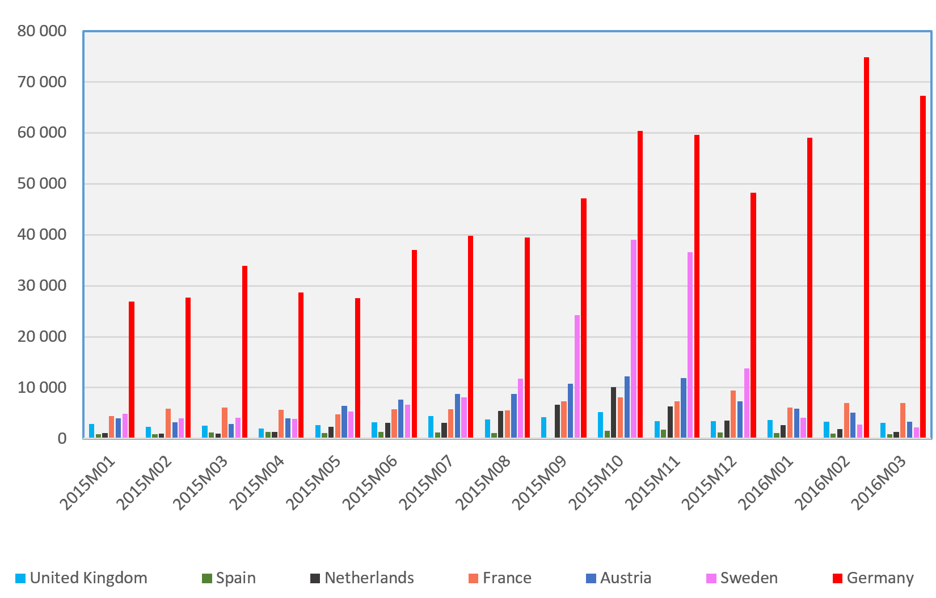
SOURCES OF MALFUNCTIONING OF THE CEAS
1) Bad design - Dublin + the role of coercion
2) Overload – unequal distribution
3) Free riders: Greece, Italy, Hungary, Croatia, Slovenia, Austria
2011 | 2012 | 2013 | 2014 | 2015 | 2016
341,795 | 373.550 | 464,505 | 662,165 | 1,322,145* | 1,236,325
Source: Eurostat data (20160313 and EASO 2017 0220)

Slide 58
WHAT SOLIDARITY IS CONCEIVABLE AMONG EU MEMBER STATES GOING BEYOND TEMPORARY PROTECTION, EASO AND AMIF,? = RELOCATION, HOTSPOTS, DUBLIN RECAST

Slide 59
Actual relocation decisions
Relocation: distributing among Member States those asylum seekers who are already within the EU and have a good chance of being recognised – i.e. members of groups with 75% recognition rate in the previous quarter (Syrians, Iraqis and Eritreans)
2 decisions:
COUNCIL DECISION (EU) 2015/1523 of 14 September 2015
40 000 persons 24,000 from Italy, 16,000 from Greece
COUNCIL DECISION (EU) 2015/1601 of 22 September 2015
120 000 persons First year: 15,600 from Italy and 50,400 from Greece Second year: 54,000 either form the same two or from other Member States.
No relocation to Denmark, Ireland, UK, Greece and Italy – 23 MS take up the 40 plus 120 thousand
Difficult cases (not „in clear need”) remain in the competence of the frontline states
Relocating MS get 6000 Euros/head
In exchange: Greece, Italy must develop „roadmap”

Slide 60
How many – the key behind the compulsory relocation decision
a) Population - 40% weighting
b) Total GDP - 40% weighting
c) Average number of asylum applications over the 5 preceding years per million inhabitants with a cap of 30% of the population and GDP - 10% weighting (reducing the share)
d) Unemployment rate with a cap of 30% of the population and GDP - 10% weighting (reducing the share)

Slide 61
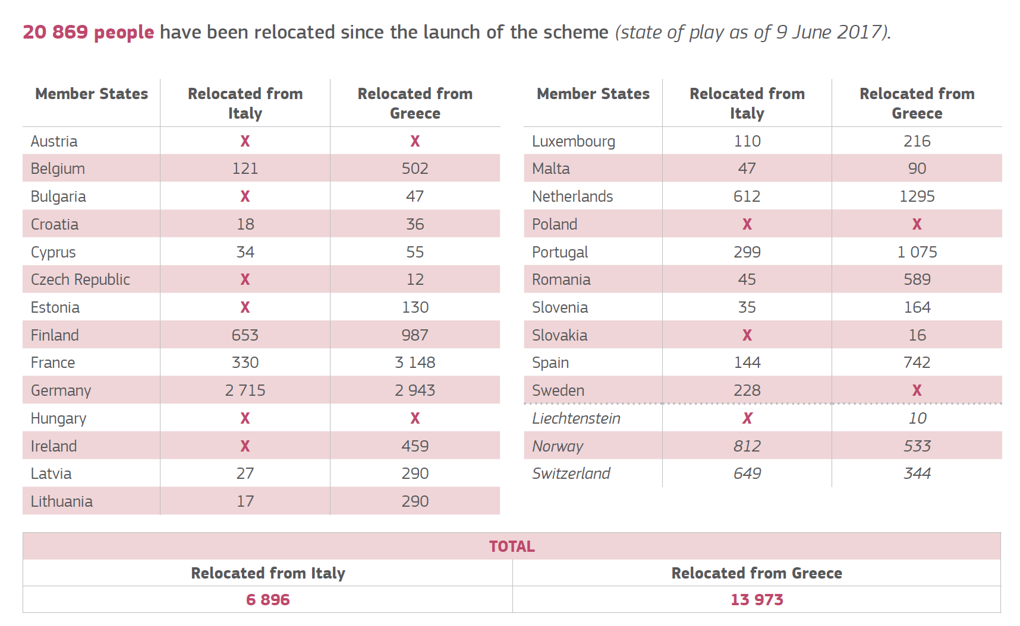
Relocation as of 9 June 2017
Source: https://ec.europa.eu/home-affairs/what-we-do/policies/european-agenda-migration/background-information_en
(20170627)
Notes:
Relocation: distributing among Member States those asylum seekers who are already within the EU and have a good chance of being recognised – i.e. members of groups with 75% recognition rate in the previous quarter (Syrians, Iraqis and Eritreans)
2 decisions:
COUNCIL DECISION (EU) 2015/1523 of 14 September 2015
40 000 persons 24,000 from Italy, 16,000 from Greece
COUNCIL DECISION (EU) 2015/1601 of 22 September 2015
120 000 persons First year: 15,600 from Italy and 50,400 from Greece Second year: 54,000 either form the same two or from other Member States.
No relocation to Denmark, Ireland, UK, Greece and Italy – 23 MS take up the 40 plus 120 thousand
Difficult cases (not „in clear need”) remain in the competence of the frontline states
Relocating MS get 6000 Euros/head
In exchange: Greece, Italy must develop „roadmap”
a) Population - 40% weighting
b) Total GDP - 40% weighting
c) Average number of asylum applications over the 5 preceding years per million inhabitants with a cap of 30% of the population and GDP - 10% weighting (reducing the share)
d) Unemployment rate with a cap of 30% of the population and GDP - 10% weighting (reducing the share)

Slide 62
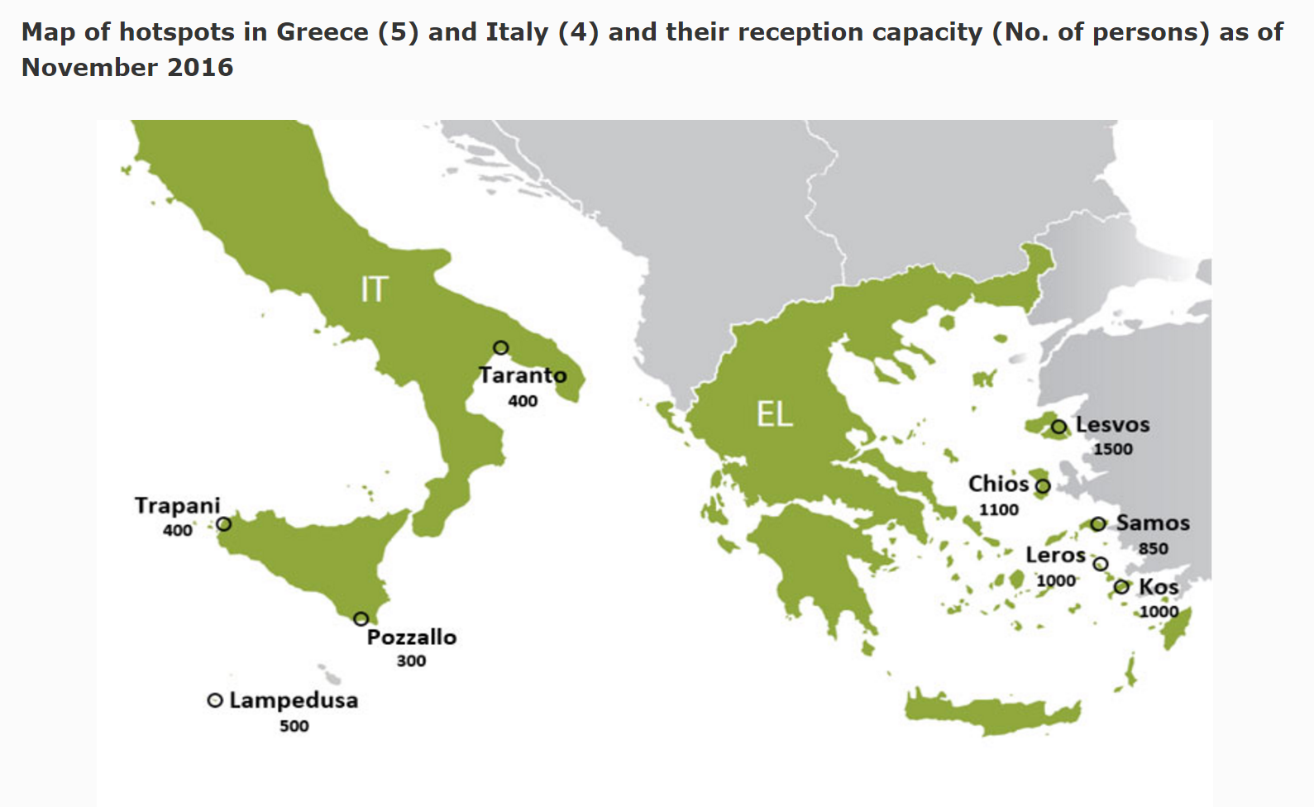
Hotspots
Hotspots = in Italy and Greece: complex sites where experts from different EU MS work together in receiving and screening the applications and organising the return of those not in need of international protection. 4 in Italy, 5 in Greece.
Notes:
10 Frontex fingerprinters, 2 debriefing teams and 2 screening teams, alongside a team of 3 EASO experts for information provision.
ECRE conclusion, December 2016
„The hotspots have certainly not helped in relieving the pressure from Italy and Greece as was their stated objective: instead, they have led to an increase in the number of asylum applicants waiting in Italy and Greece, consolidating the challenges and shortcomings already inherent in the Dublin system. The hotspots approach has also led to more repressive measures, often disrespecting fundamental rights, which are applied by national authorities as a result of EU pressure to control the arrivals; yet despite EU pressure, it is the Member States that are held ultimately responsible for this implementation. The implementation of the EU-Turkey deal is a prime example of this EU pressure shifting responsibilities to the national level.”

Slide 63
Efforts to recast the CEAS - overview
New asylum acquis package, 2016 Spring and Summer
Priorities
1) Establishing a sustainable and fair system for determining the Member State responsible for asylum seekers
Adapting the Common European Asylum System to deal better with the arrival of a high number of asylum seekers/refugees amend the Dublin Regulation corrective fairness mechanism based on a distribution key.
2 ) Reinforcing the Eurodac system
3) Achieving greater convergence in the EU asylum system
Strengthening and harmonising further the Common European Asylum System rules, so as to ensure more equal treatment across the EU and reduce undue pull factors to come to the EU.
Regulation establishing a single common asylum procedure, a new Qualification Regulation replacing targeted modifications of the Reception Conditions Directive.
4) Preventing secondary movements within the EU
Sanctions in the new regulations and the reception condition directive to discourage and sanction irregular moves to other Member States.
5) Creation of a European Asylum Agency
with new policy-implementing role as well as a strengthened operational role and providing sufficient financial resources and legal means for that purpose.
c
c
c
c
c

Slide 64
THE PROPOSED CHANGES AFFECTING INTER-STATE SOLIDARITY IN DUBLIN IV.
In take back situations – only notification – no request – duty to take back. (Responsibility does not expire with time)
Chapter VII: Corrective allocation mechanism
Disproportionate number of applications (after eligibility)
Exceeds 150 % of reference key (including resettled refugees)
Reference key = total of application in EU – share by MS based on
population size 50 -50 % weight
total GDP
If unwilling to participate 250 000 Euros/per each applicant, who would have been allocated
Automated system

Slide 65
SOLIDARITY WITH THIRD STATES, COOPERATION, EXTERNALISATION

Slide 66
RESETTLEMENT FROM THIRD STATES
The ad hoc decision of 20 July 2015 of the „Representatives of the Governments of the Member States meeting within the Council” (EU Doc 11130 /1 5) = Conclusions of the on resettling through multilateral and national schemes 20 000 persons in clear need of international protection
Union Resettlement Framework – Commission Proposal of 13 July 2016 (COM (2016) 468 final
Council – in „Annual Union resettlement Plan”- sets
Annual maximum total number
Number of persons to be taken by each MS (based on their offers)
Geographic priorities
Commission - in „Targeted Union resettlement schemes” – sets
The actual number to be resettled by each state
Details of regions, specificities of co-operation
MS choose the actual persons, who have to consent to the resettlement
EU –Turkey Statement of 18 March 2016
1 : 1 Scheme – for a Syrian taken back from greece another Syrian refugee from Turkey to be resettled to the EU
Notes:
Council of the European Union Brussels, 22 July 2015 (OR. en) 11130/15 ASIM 62 RELEX 633 NOTE
ANNEX Conclusions of the Representatives of the Governments of the Member States meeting within the Council on resettling through multilateral and national schemes 20 000 persons in clear need of international protection

Slide 67
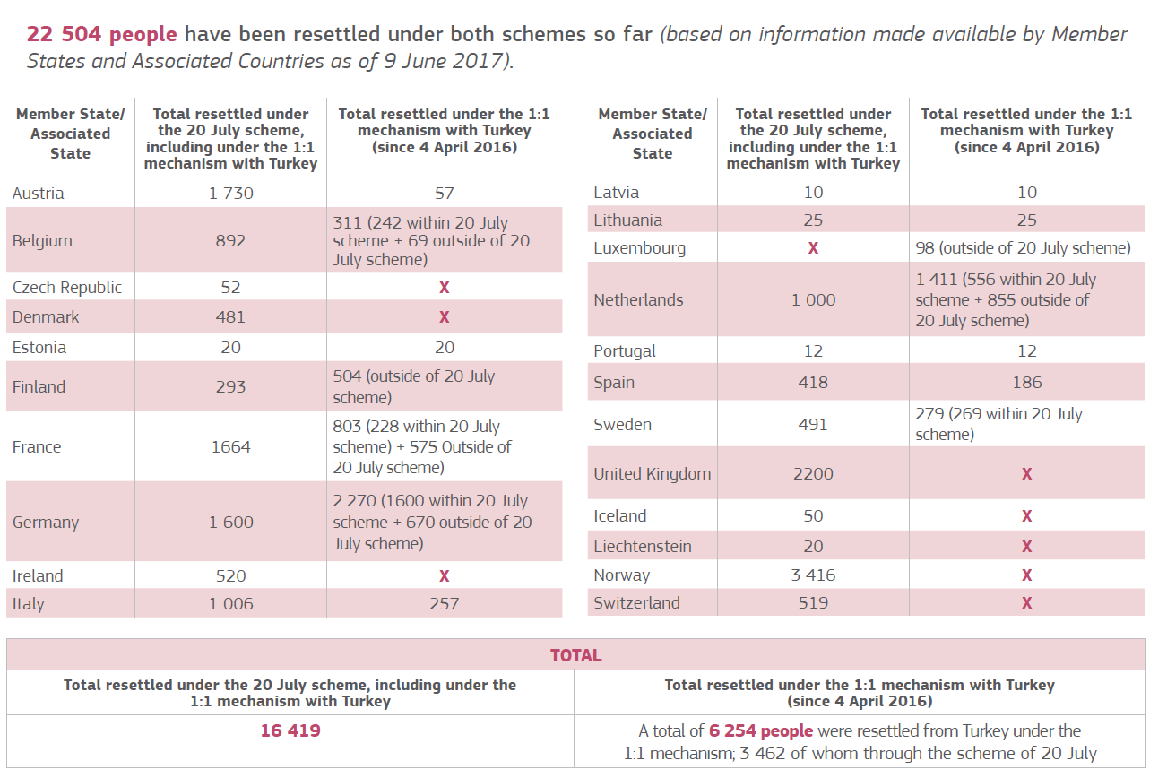
Actual resettlement
Source: https://ec.europa.eu/home-affairs/what-we-do/policies/european-agenda-migration/background-information_en (20170627)

Slide 68
Financial assistance
Emergency Trust Fund for stability and addressing the root causes of irregular migration and displaced persons in Africa.
Goals:
foster stability in the regions;
contribute to better migration management.
by addressing the root causes of destabilisation, forced displacement and irregular migration, by promoting economic and equal opportunities, security and development.
2 556 million Euros pledged
EU Regional Trust Fund in Response to the Syrian Crisis
Countries covered: Egypt, Iraq, Jordan, Lebanon, Turkey, but also some Western Balkan states
Improving education, livelihoods and health
Goal: 1 000million Euros by 2017

Slide 69
The EU-Turkey „statement” – the deal of 18 March 2016
„[A]ny application for asylum will be processed individually by the Greek authorities in accordance with the Asylum Procedures Directive, in cooperation with UNHCR”
„All new irregular migrants crossing from Turkey into Greek islands as from 20 March 2016 will be returned to Turkey. This will take place in full accordance with EU and international law, thus excluding any kind of collective expulsion.”
„[T]emporary and extraordinary measure”
„Migrants not applying for asylum or whose application has been found unfounded or inadmissible in accordance with the said directive will be returned to Turkey”
Turkey suspended the implementation of that point in March 2017

Slide 70
The EU-Turkey „statement” – the deal of 18 March 2016
„For every Syrian being returned to Turkey from Greek islands, another Syrian will be resettled from Turkey to the EU taking into account the UN Vulnerability Criteria”
Visa liberalisation among Schengen states for Turkey by the end of June 2016
Opening Chapter 33 in the accession negotiations
3 + 3 billion Euros for the Facility for Refugees in Turkey
Notes:
„[R]esettlement under this mechanism will take place, … honouring the commitments [of 20 July 2015], of which 18.000 places for resettlement remain. Any further need for resettlement will be carried out through a similar voluntary arrangement up to a limit of an additional 54.000 persons.” … The Commission's will propose an amendment to the relocation decision of 22 September 2015 to allow for any resettlement commitment undertaken to be offset from non-allocated places under the decision… Should the number of returns exceed the numbers provided for above, this mechanism will be discontinued.”
- A mechanism up to 72 000 resetllements. No plan for afterwards
- Purely voluntary

Slide 71
CONCLUSION DEMISE OR SOLIDARITY

Slide 72
Geographic proximity is morally irrelevant – then who should provide the public good of protection globally and regionally?
Why would Lebanon be more obliged to protect Syrian refugees (or Iran to protect Afghanis, or Kenya Somalis, etc.) than Italy, Germany or Finland?
Protection globally is a public good to which every member state of the global community should contribute. Free riding is immoral and antisocial

Slide 73
Demise of solidarity
EU at present
Increases coercive tools
(keeping out, penalizing for entry, detaining, transferring between countries by force = more of the policy which did not work
Pursues externalisation
Struggles with finding a principle for (flexible) solidarity
EU should „Sollen”
See itself as a unified protection space
Introduce significant resettlement quotas and/or humanitarian visas
Contribute more to stopping the crises in the countries of origin
Open up wider routes of regular immigration
Effectively remove those without the right to stay
„Deterrence paradigm” Gammeltoft-Hansen and Tan

Slide 74
(Some) Available options
Decision making on asylum requests at the European level by EU agencies, on behalf of the EU (K. Hailbronner, G Goodwin-Gill)
Decision making at national level under national law, but with the active and intensive participation of EU staff (Heijer, Rijpma, Spijkerboer)
Conceivable arrangement: asylum seekers choose their country of preference which conducts the RSD. All costs associated with the reception, the procedure, the integration or the removal are aggregated and redistributed across the EU

Slide 75
THANKS!
BOLDIZSÁR NAGY E-mail:nagyb@ceu.edu www.nagyboldizsar.hu

